Slide 1
Customer churn prediction using composite deep learning technique
SivA Sai pavan karthik Uppalapati

Slide 2
Authors
Asad Khattak , Zartashia Mehak , Hussain Ahmad , Muhammad Usama Asghar , Muhammad Zubair Asghar & Aurangzeb Khan

Slide 3
What is the Paper about?
Customer churn presents both challenges and exciting opportunities for businesses, as it highlights the importance of customer satisfaction in a competitive landscape. While traditional methods like machine learning have been useful, they've often faced hurdles. That's where our innovative hybrid deep learning model, BiLSTM-CNN, shines! This model demonstrates remarkable accuracy of 81% in predicting customer churn using benchmark data.

Slide 4
In the fast-paced telecommunications sector, retaining customers is vital for success. Understanding why customers leave is essential for creating effective retention strategies. By analyzing customer data, businesses can not only improve service quality but also proactively address potential issues. Embracing these insights allows companies to faster strong relationships and turn challenges into growth opportunities, ensuring a brighter, more successful future!

Slide 5
What is the Motivation?
Customer churn significantly impacts businesses, leading to potential losses and sometimes even closures. Customers may switch providers due to factors like pricing, delivery methods, customer service experiences, product quality, or unmet expectations. Losing customers is costly, making retention crucial for sustainability. Data analysis plays a vital role in predicting churn, helping companies understand why customers leave and what actions to take.
Traditional churn prediction methods often face scalability issues, as many machine learning models rely on manual feature engineering. For instance, Gupta's study found that KNN classification struggles to accurately identify at-risk clients.

Slide 6
Goal of research
Many researchers have investigated using machine learning (ML) techniques to predict customer attrition, focusing primarily on early detection. This focus has created challenges in understanding the interactions between predictors of customer churn. In this paper, we propose a hybrid deep learning model, BiLSTM + CNN, which combines bidirectional long/short-term memory (BiLSTM) with convolutional neural networks (CNN) to predict customer turnover. This approach aims to enhance existing classifiers and improve prediction accuracy by addressing the limitations of unidirectional LSTM layers and effectively categorizing data into churn and non-churn categories.

Slide 7
Methods they used
Data Preprocessing
Handling missing values
Feature scaling like Min-Max, Standard Scaler)
Feature Engineering
Sequence structuring for BiLSTM input
BiLSTM Architecture
Bidirectional LSTM to capture forward and backward dependencies
CNN Architecture
1D Convolutional layers applied to BiLSTM output
Hybrid Model Integration
Input → BiLSTM → CNN → Dense Layers → Sigmoid Output
Model Training
Binary cross-entropy loss function

Slide 8
Evaluation Metrics
Used to boost Accuracy, Precision, Recall, F1 Score
Baseline Model Comparison
Compared BiLSTM-CNN with:
Logistic Regression
Random Forest
CNN
LSTM
BiLSTM
Performance Analysis
Quantitative performance analysis using multiple metrics
Visualization of results via grapgs and confusion matrices

Slide 9
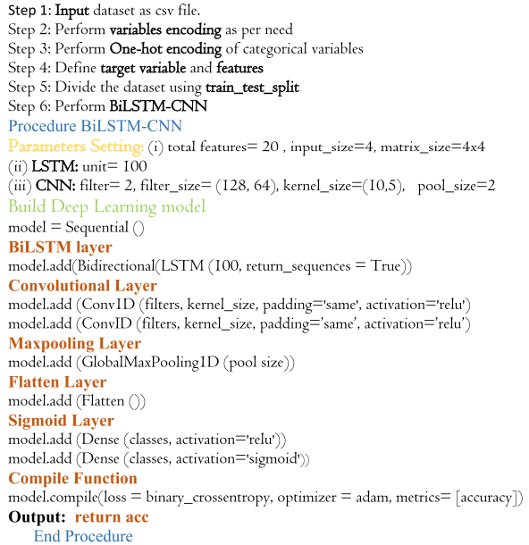
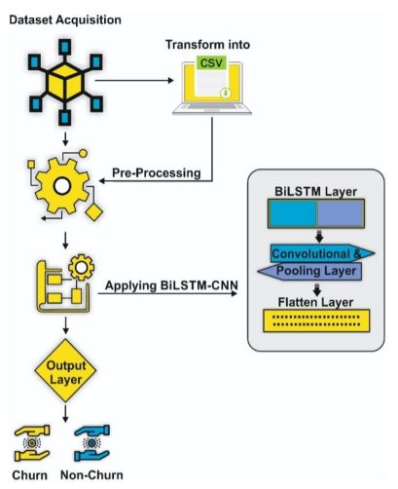
Implementation

Slide 10
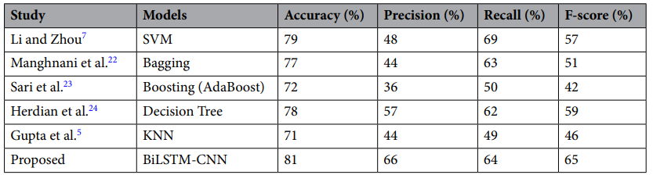
Results

Slide 11
What I am Doing?
Customer Churn Prediction Chatbot for Subscription Services using AI

Slide 12
As discussed in the paper Subscribers can decide the business for subscription based organizations like Telecom, service based sites, OTT & banks etc……
I am Focusing particularly on OTT and banks.
Now a days these the keys Subscription based business commonly using.
My aim is to develop a working chatbot which predicts the churn based on the few inputs give by the users.

Slide 13
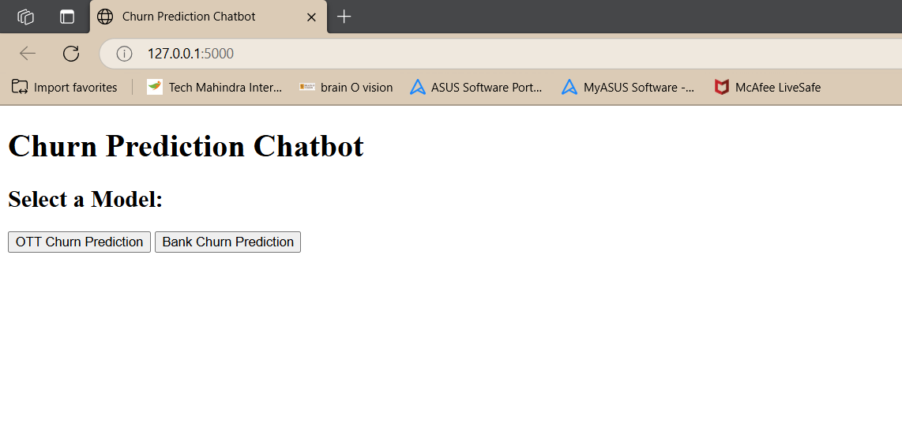
This is the AI chatbot interface
Need to select what you want to choose.

Slide 14
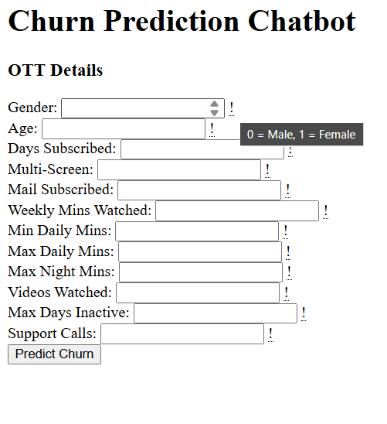
Ott based prediction
This is how the Ott prediction looks like
Need give the required to predict
Add the range how the values should be for a user friendly environment

Slide 15
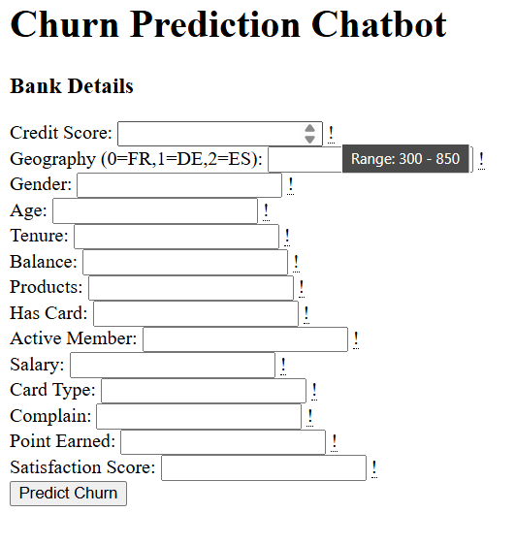
Bank Based Prediction

Slide 16
Questions

Slide 17
Thank You

